Slide 1
Bitcoin OTC - Network Analysis
Arvind Dwarkasing - 1534009
Michail Vrachasotakis - 4749189
Conrad Brown - 4615158
Nivedita Prasad - 4712099
Haoming Yeh - 4386027
Notes:
CB

Slide 2
Dataset - Bitcoin OTC TWSN
Temporal edge weighted signed network (TWSN)
Bitcoin exchanged for money and users rate each other during exchange
Dataset columns
  Node #5880 nodes
  Rating given by source node to destination node ranging from -10 to 10
  Time Stamp - Spans 272 weeks (2011 - 2015)
  Directed graph
Notes:
CB

Slide 3
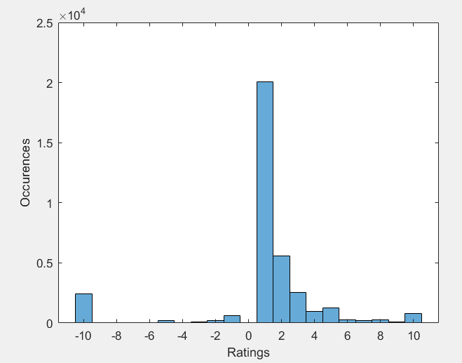
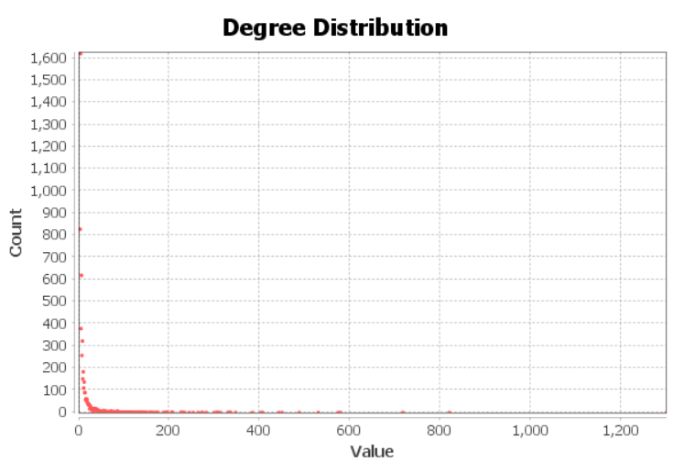
Network statistics
Histogram of Network Ratings
Degree Distribution
Notes:
H

Slide 4
Research Questions
How can we detect fraudulent users in a Temporal Edge Weighted Signed Network (TWSN)?
Can we use Social Motif structures to predict fraudulent nodes?
Can rating time differences be used to predict fraudulent behaviour?
Notes:
H

Slide 5
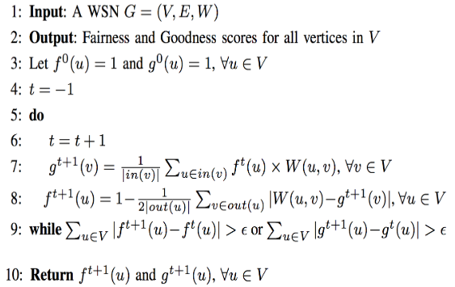
Definitions (1/3)
Fairness: High value means the user gave other users ratings close to the ‘deserved’ value.
Goodness: High value means user received high ratings from other fair users.
Formally fairness and goodness are calculated recursively as per the algorithm
Notes:
N

Slide 6
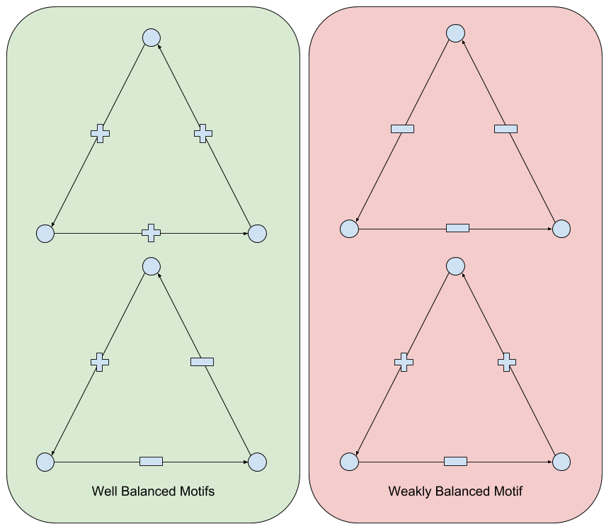
Definitions (2/3)
Fairness and goodness thresholds are set to 0.65 and 0 respectively. Nodes with values less than these thresholds are considered fraudulent.
Rating time difference regularity. Detect pattern in time difference between sequential events for a node
Social balance motifs, we have 2 kinds as per the below diagram
Notes:
N

Slide 7
Definitions (3/3)
Social balance motifs - well and weak balanced triangles according to social network theory
Odd number of negative ratings - weak balanced
Notes:
N

Slide 8
Methodology
Define metrics
  Fairness
  Goodness
  Social balance motifs
  Rating time difference
Define list of fraudulent users
Compute distributions of fraudulent vs non-fraudulent users
Correlation between metrics
Use classifiers on metrics
Notes:
C

Slide 9
Constructing integrated fairness and goodness
Construct list of all nodes in the complete dataset, initial rating of 1
Per event calculate fairness (f) and goodness (g) of all nodes up until that point
Speed up calculation by taking the previous timesteps rating
At final timestep we have the f and g off all nodes over integrated graph
Notes:
C

Slide 10
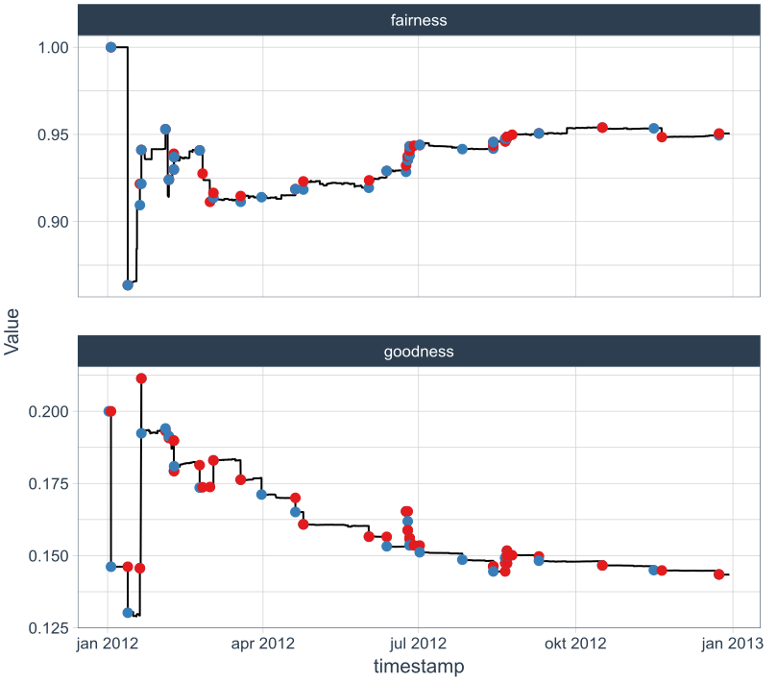
Constructing integrated fairness and goodness
Notes:
C

Slide 11
Notes:
C

Slide 12
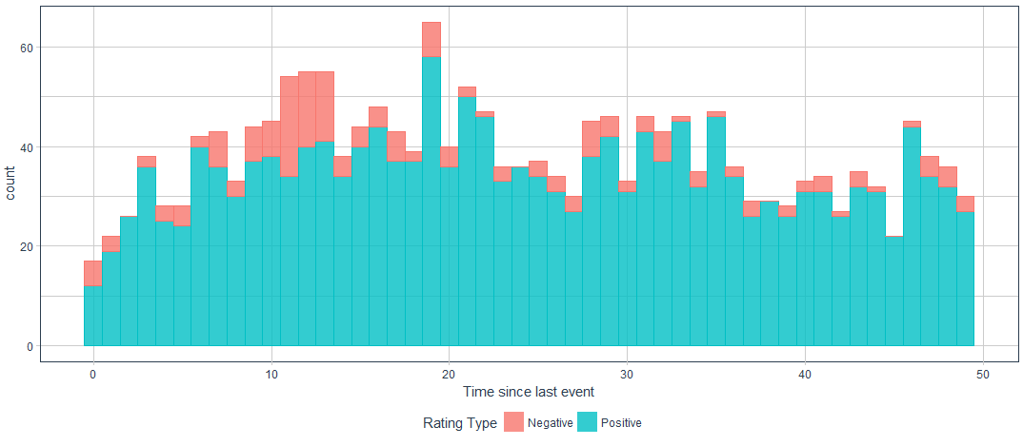
Time difference between rating events
Notes:
N

Slide 13
Time difference between rating events
Notes:
N

Slide 14
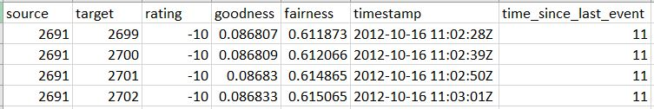
Time difference between rating events
Node 2691 - Bot
Notes:
N

Slide 15
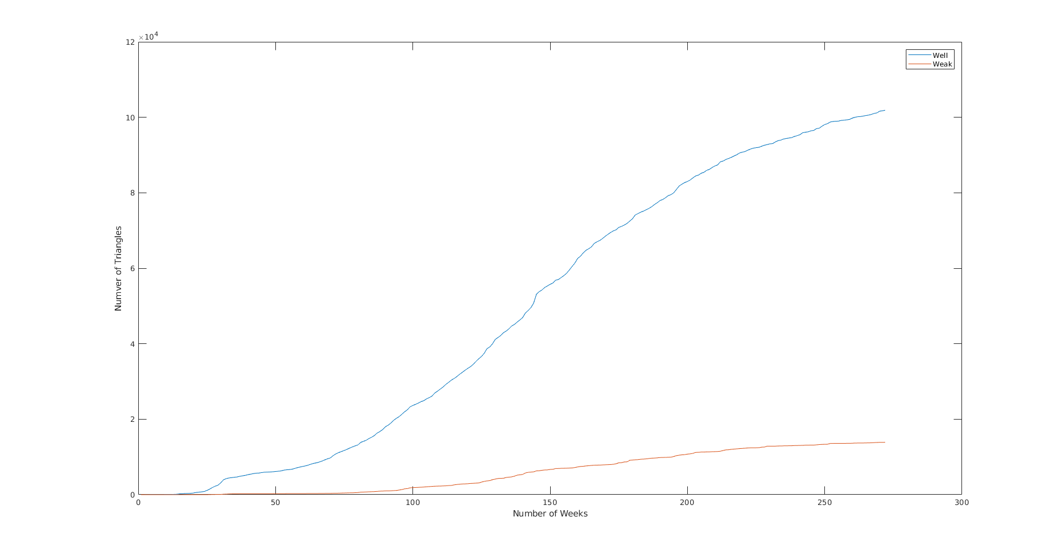
Social Balance Metrics - Number of Triangles
Notes:
M

Slide 16
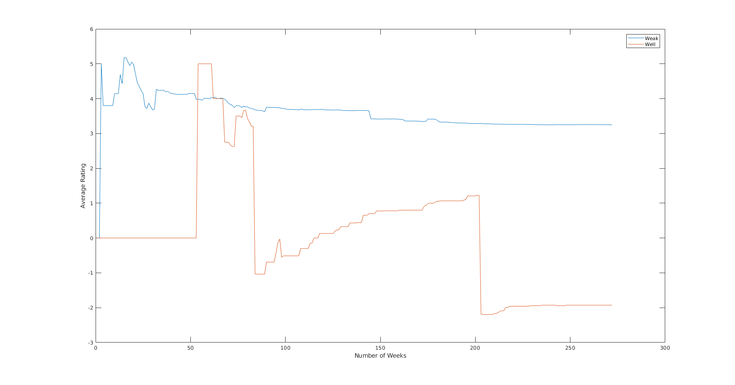
Social Balance Metrics - Average triangle rating per node
Notes:
M

Slide 17
Notes:
C

Slide 18
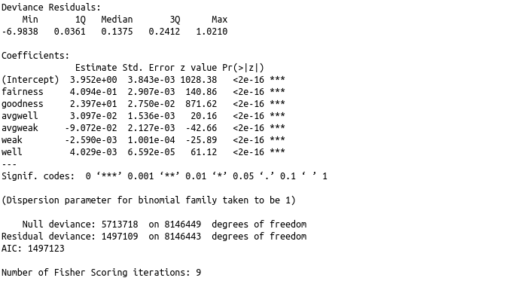
Results - Logistic Regression 2012
Notes:
M

Slide 19
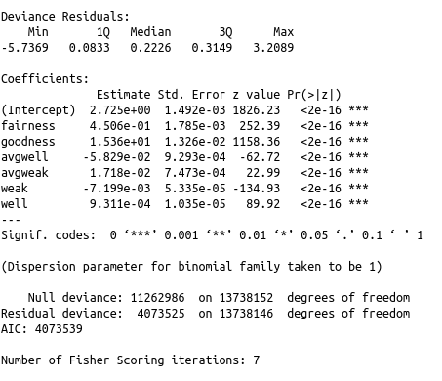
Results - Logistic Regression 2013
Notes:
M

Slide 20
Results - Fraudulence Classification 2012
Training set: 80% Test set: 20%
Classifiers from different categories instead of cross-validation on one classifier
Classifiers | LDA (Linear Discriminant Analysis) | SGC (Stochastic Gradient Descent ) | GNB (Gaussian Naive Bayes) | DTC (Decision Tree) | RFC (Random Forest) | MLPC (Multi-layer perceptron) | VC (DTC+LDA+GNB)
All features | 0.922 | 0.982 | 0.936 | 0.99 | 0.99 | 0.991 | 0.953
Only goodness | 0.91 | 0.983 | 0.918 | 0.98 | 0.98 | 0.983 | 0.924
Notes:
M

Slide 21
Discussion
Evaluation of fraudulence metrics using pre-labeled fraudulent nodes
Compare fraudulent metrics vs general network characteristics for fraud detection
Use a generated model of the TWSN/ different datasets
Notes:
H
Using the fairness and goodness score we can define a ground truth of fraudulent nodes. We then show that these are correlated with certain motif structures. We can then use the motif structures as well as fairness/goodness scores to predict fraudulent nodes. This would be a useful way to flag to administrators which users to investigate more closely, and also as an automated way to flag to users which other users they may wish to be wary off.
Broaden fraudulence predictors since by our definition the list is small, avoid false positives and false negatives

Slide 22
Conclusion
Fraudulent nodes are detected by thresholding on fairness and goodness
Both motifs and fairness and goodness scores are useful predictors of potential fraudulent activity in TWSN
Goodness seems better than fairness for prediction fraud
Rating time difference is a good identifier for bots. (Assumed to be bots)
Notes:
H

Slide 23
References
S. Kumar, F. Spezzano, V. S. Subrahmanian and C. Faloutsos, "Edge Weight Prediction in Weighted Signed Networks," 2016 IEEE 16th International Conference on Data Mining (ICDM), Barcelona, 2016, pp. 221-230. doi: 10.1109/ICDM.2016.0033
URL: http://ieeexplore.ieee.org/stamp/stamp.jsp?tp=&arnumber=7837846&isnumber=7837813
Kai-Yang Chiang, Cho-Jui Hsieh, Nagarajan Natarajan, Ambuj Tewari and Inderjit S. Dhillon, “Prediction and Clustering in Signed Networks: A Local to Global Perspective”,
CoRR, abs/1302.5145}, 2013, URL: http://arxiv.org/abs/1302.5145
Data can be found in http://snap.stanford.edu/data/soc-sign-bitcoinotc.html
Visualization done using Gephi - URL: https://gephi.org/
Python package scikit.learn used for classification.
Matlab and R standard functions have been used.

Slide 24
Division of labour
Arvind: Integrated table of fairness and goodness for each node in 2012 and 2013, time difference between sequential events analysis
Haoming: Visualization of temporal graph, Network Statistics
Conrad: Visualizations of evolving distributions, created a version of the integrated fairness/goodness algorithm
Nivedita: Worked with Michalis for Social Motifs - Triangles
Michalis: Maximum clique, Social Balance motifs and evaluation using classifiers, Network statistics

